Slide 1
ETHICAL HACKING
:
NAME
VAKATI YASASWINI
ROLL NO
:
20AK1A05G2
SECTION
:
CSE

Slide 2
Content
Introduction
Ethical Hacking
Who are Hackers
Why do Hackers hack
Types of Hackers
What should do after hack
Hacking Process

Slide 3
Content
Why do We need Ethical Hacking
Required Skills of an Ethical Hacking
What do hackers do after Hacking?
Advantages
Disadvantages
Future Enhancements
Conclusion

Slide 4
Introduction
Ethical hacking also known as penetration testing or white-hat hacking ,involves the same tools ,tricks ,and techniques that hackers use ,but with one major difference that Ethical hacking is legal.

Slide 5

Ethical Hacking
Independent computer security Professionals breaking into the computer systems.
Neither damage the target systems nor steal information.
Evaluate target systems security and report back to owners about the bugs found.

Slide 6

Who are Hackers?
A person who enjoys learning details of a programming language or system.
A person who enjoys actually doing the programming rather than just theorizing about it.
A person capable of appreciating someone else's hacking.
A person who picks up programming quickly.
A person who is an expect at a particular
programming language or system.

Slide 7

Why do hackers hack?
Just for fun.
Show off.
Hack other systems secretly.
Notify many people their thought.
Steal important information.
Destroy enemy's computer network during the war.

Slide 8
Ethical Hackers but not Criminal Hackers
Completely trustworthy.
Strong programming and computer networking skills.
Learn about the system and trying to find its weakness.
Techniques of Criminal hackers-Detection-Prevention.

Slide 9
Types of Hackers
Black Hat Hacker
White Hat Hacker
Grey Hat Hacker

Slide 10

Black-Hat Hacker
A black hat hackers o crackers are individuals with extraordinary computing skills ,resorting to malicious or destructive activities.
That is black hat hackers use their knowledge and skill for their own personal gains probably by hurting others.

Slide 11

White-Hat Hacker
White hat hackers are those individuals professing hacker skills and using them for defensive purposes.
This means that the white hat hackers use their knowledge and skill for the good of others and for the common good.

Slide 12
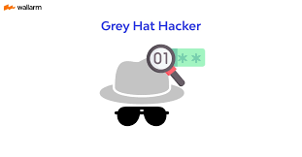
Grey-Hat Hackers
These are individuals who work both offensively and defensively at various times.
We cannot predict their behaviour.
Sometimes they use their skills for the common good while in some other times he uses them for their personal gains.

Slide 13

What should do after hacked?
Shutdown or turn off the system
Separate the system from network
Restore the system with the backup or reinstall all programs
Connect the system to the network
It can be good to call the police

Slide 14
Hacking Process
Foot Printing
Scanning
Gaining Access
Maintaining Access

Slide 15
Foot Printing
Who is lookup
NS lookup
IP lookup

Slide 16
Scanning
Port Scanning
Network Scanning
Finger Printing
Fire Walking

Slide 17
Gaining Access
Password Attacks
Social Engineering
Viruses

Slide 18
Maintaining Access
Os BackDoors
Trojans
Clears Tracks

Slide 19
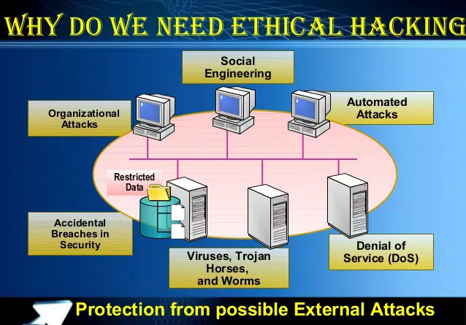
Need of Ethical Hacking

Slide 20
Required Skills of an Ethical Hacker
Microsoft: Skills in operation ,configuration and management.
Linux: Knowledge of Linux/Unix; security setting, configuration ,and operation of instruction detection systems.

Slide 21
Required Skills of an Ethical Hacker....
Routers: Knowledge of routers ,routing protocols, and access control lists
Mainframes: Knowledge of mainframes
Network Protocols: TCP/IP; how they function and can be manipulated.
Project Management: Leading ,planning ,organizing ,and controlling a penetration testing team.

Slide 22
What do hackers do after hacking?...
Patch Security hole
The other hackers can't intrude
Clear logs and hide themselves
Install rootkit (backdoor)
The hacker who hacked the system can use the system later
It contains trojan virus ,and so on
Install irc related program
Identd, irc, bitchx, eggdrop, bnc

Slide 23
What do hackers do after hacking?
Install scanner program
Mscan, sscam, nmap
Install exploit program
Install denial of service program
Use all of installed programs silently

Slide 24
Advantages
To catch a theif you have to think like a thief.
Helps in closing the open holes in the system network.
Provides security to banking and financial establishments.
Prevents website defacements.
An evolving technique.

Slide 25
Disadvantages
All depends upon the trustworthiness of the ethical hacker
Hiring professionals is expensive.

Slide 26
Future Enhancements
As it an evolving branch the scope of enhancement in technology is immense.
No ethical hacker can ensure the system security by using the same technique repeatedly.
More enhanced software's should be used for optimum protection.

Slide 27
Conclusion
In the preceding sections we saw the methodology of hacking, why should we aware of hacking and some tools which a hacker may use.
Now we can see what can we do against hacking or to protect ourselves from hacking.
The first thing we should do is to keep ourselves updated about those software's we and using for official and reliable sources.
Educate the employees and the users against black hat hacking.

Slide 28
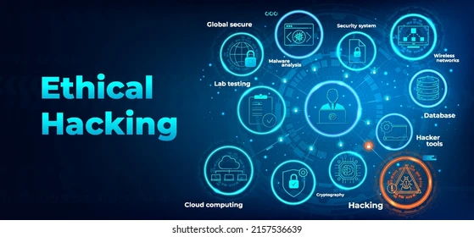
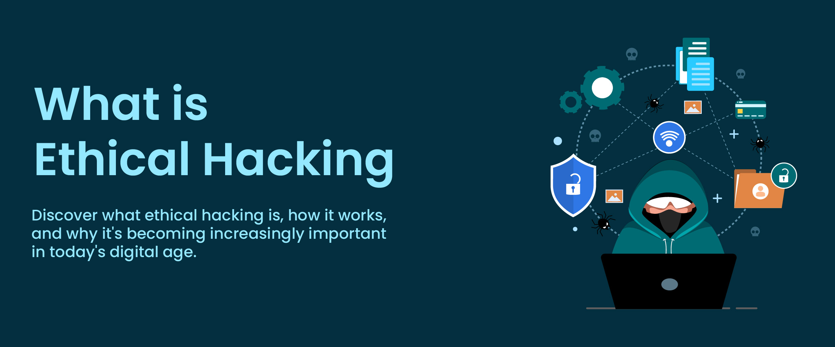
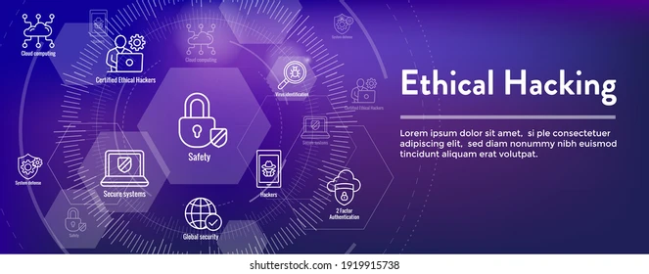


Slide 29


